Slide 1
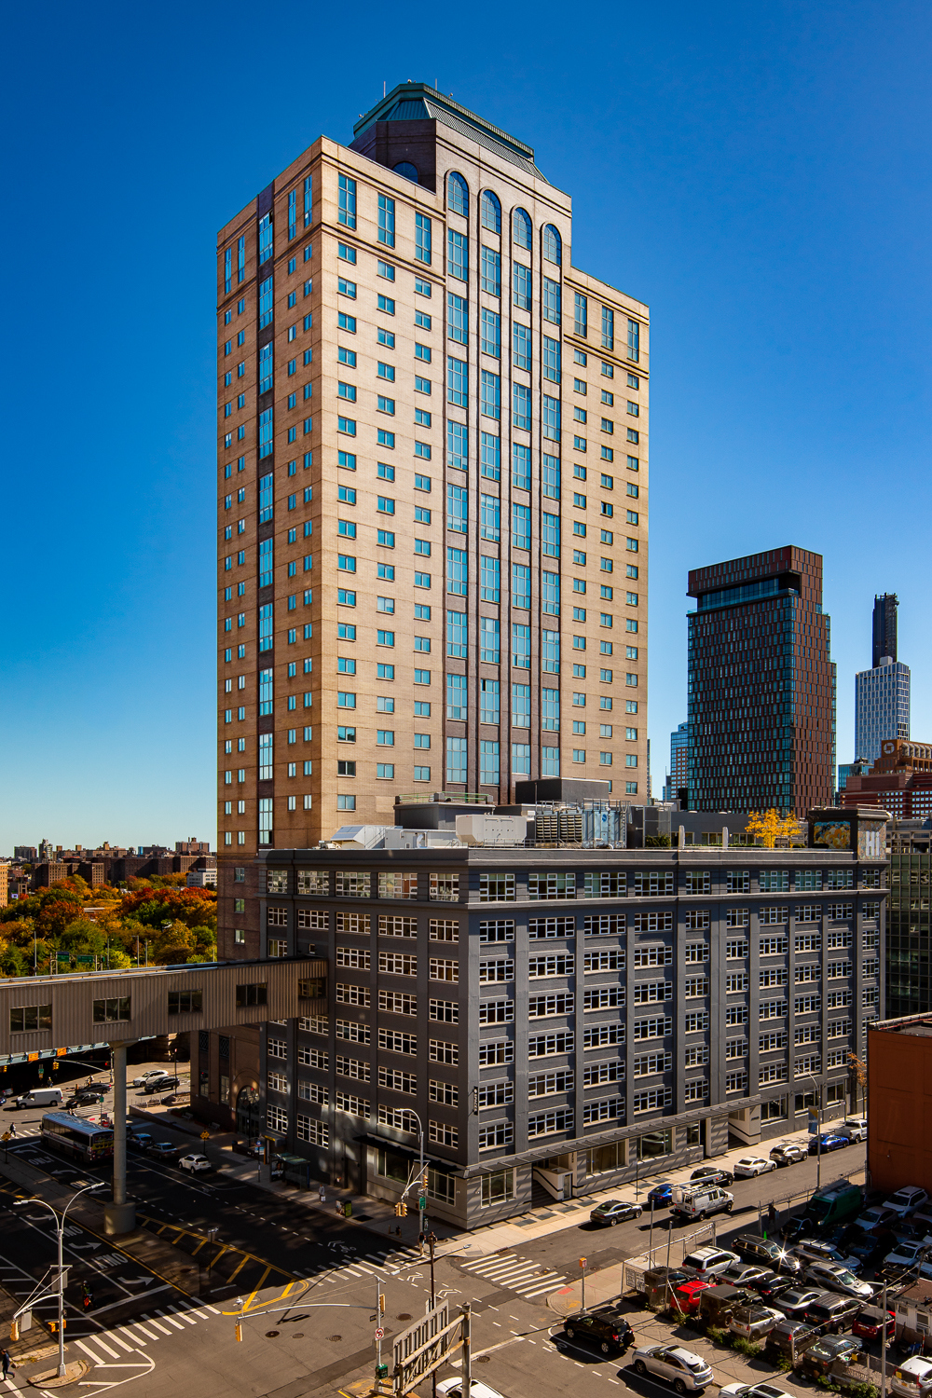
90 Sands (Brooklyn, NY)
Rehabilitation, Redevelopment, Repurposing of former
Jehovah Witnesses’ Hotel in DUMBO, Brooklyn
30-story Tower with 491 Apartments
305 Supportive Housing Furnished Apartments for
formerly homeless individuals diagnosed with either a
substance-use disorder or a serious mental illness
185 additional Rent-Restricted Extremely Low- to
Moderate-Inc. Units
Supportive services include case management, primary
medical care, mental health services, employment readiness,
and benefits counseling, among others
Amenities include a 24-hour attended lobby, security camera
system throughout, multipurpose room for community events
and meetings, a digital library, a fitness room, and extensive
bike storage
Site also includes a newly activated plaza for public use

