Slide 1
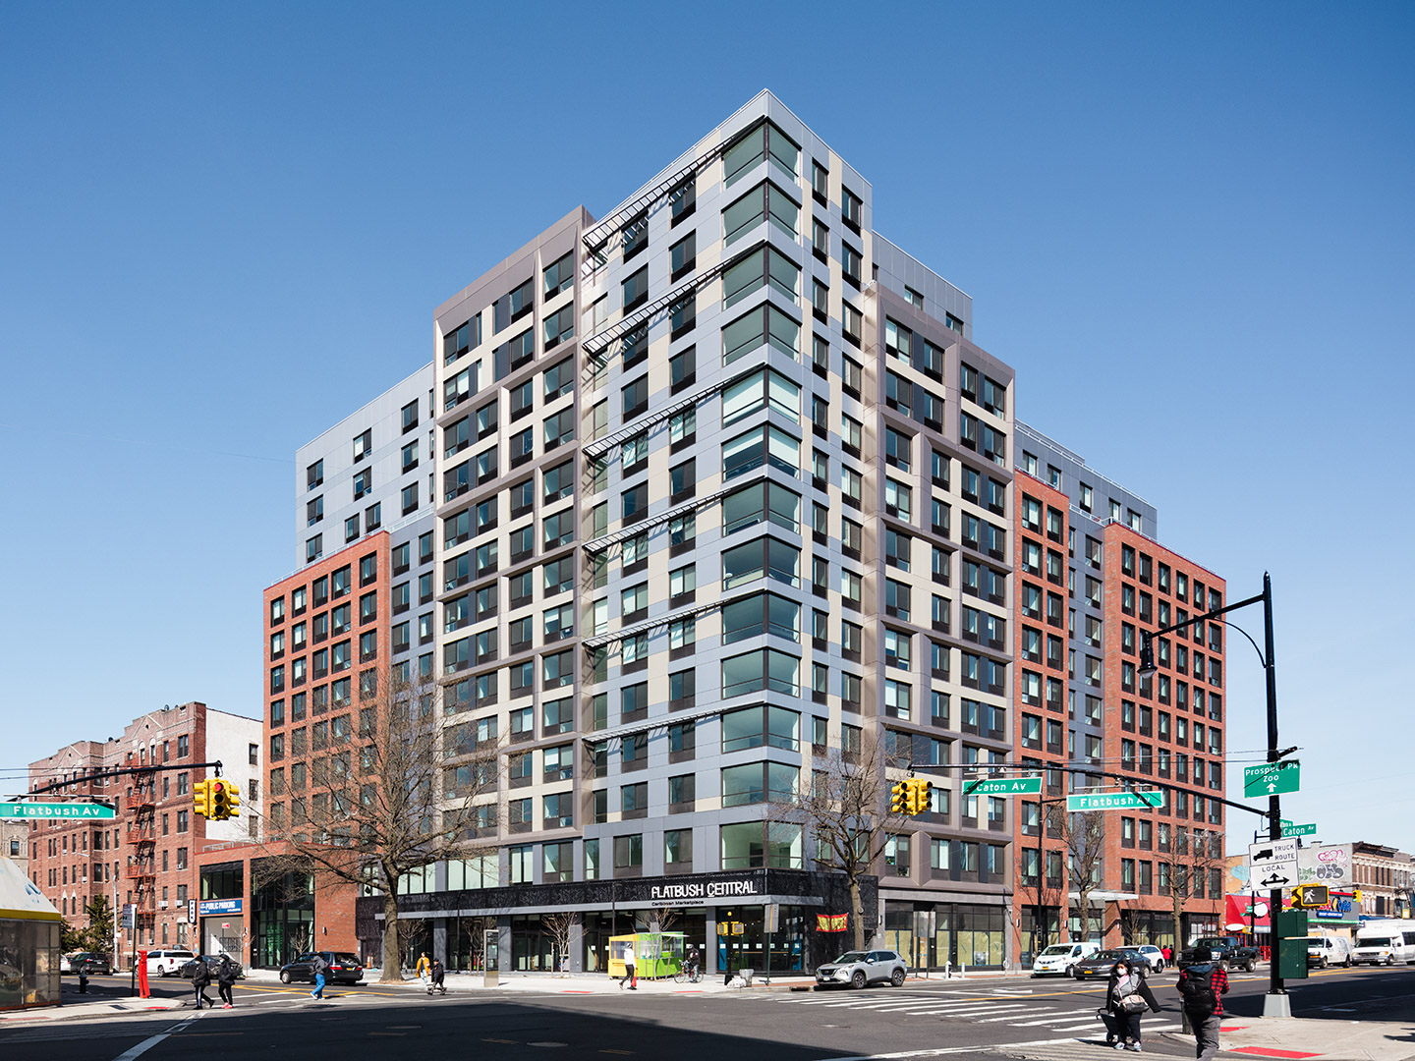
Caton Flats, Flatbush, Brooklyn
Innovative, Newly Constructed, Mixed-Use,
Mixed-Income, Affordable Housing, Economic, and Cultural HUB
14-Story, 255 Apartments with 115 Apartments remaining affordable in perpetuity
Affordable Housing Levels range from 40% to 165% of the Area Median Income (AMI) with apartment sizes ranging from studio to three-bedroom apartments
Over 20,000 sqft. of community and commercial space to include the former “Flatbush Caton Market” now dubbed “Flatbush Central” an economic and cultural anchor to the local community
The market is home to the “Mangrove” accelerator—economic mobility platform and incubator program encouraging growth of new and existing small local businesses
The Mangrove Incubator program specifically targets Black, Indigenous, and People of Color (BIPOC) entrepreneurs as a means of support to grow new BIPOC businesses
Innovative Financing to include a Forward Bond Purchase Agreement, Taxable and Tax-Exempt bonds as well as other subsidies and enhancements

