Slide 1
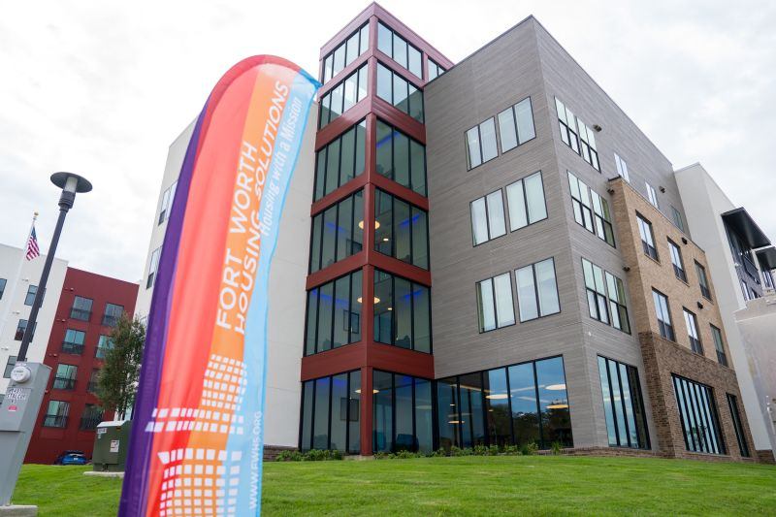
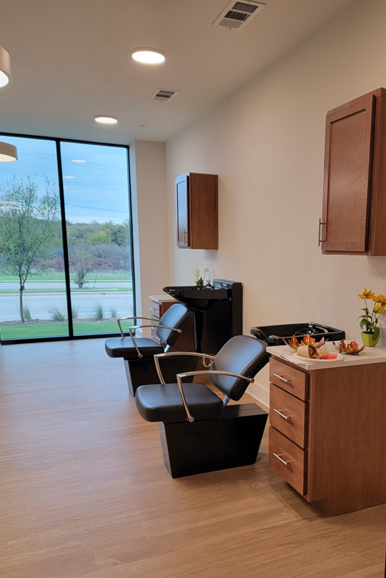
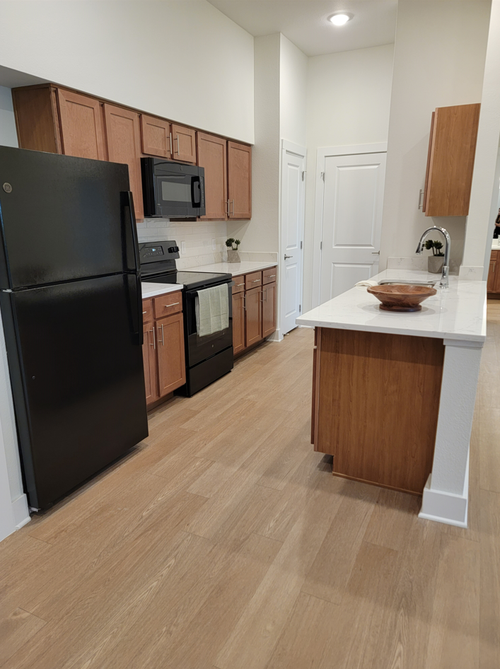
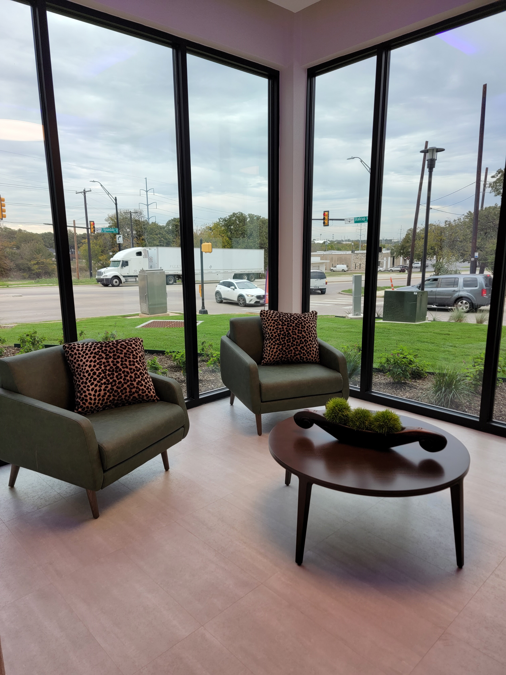
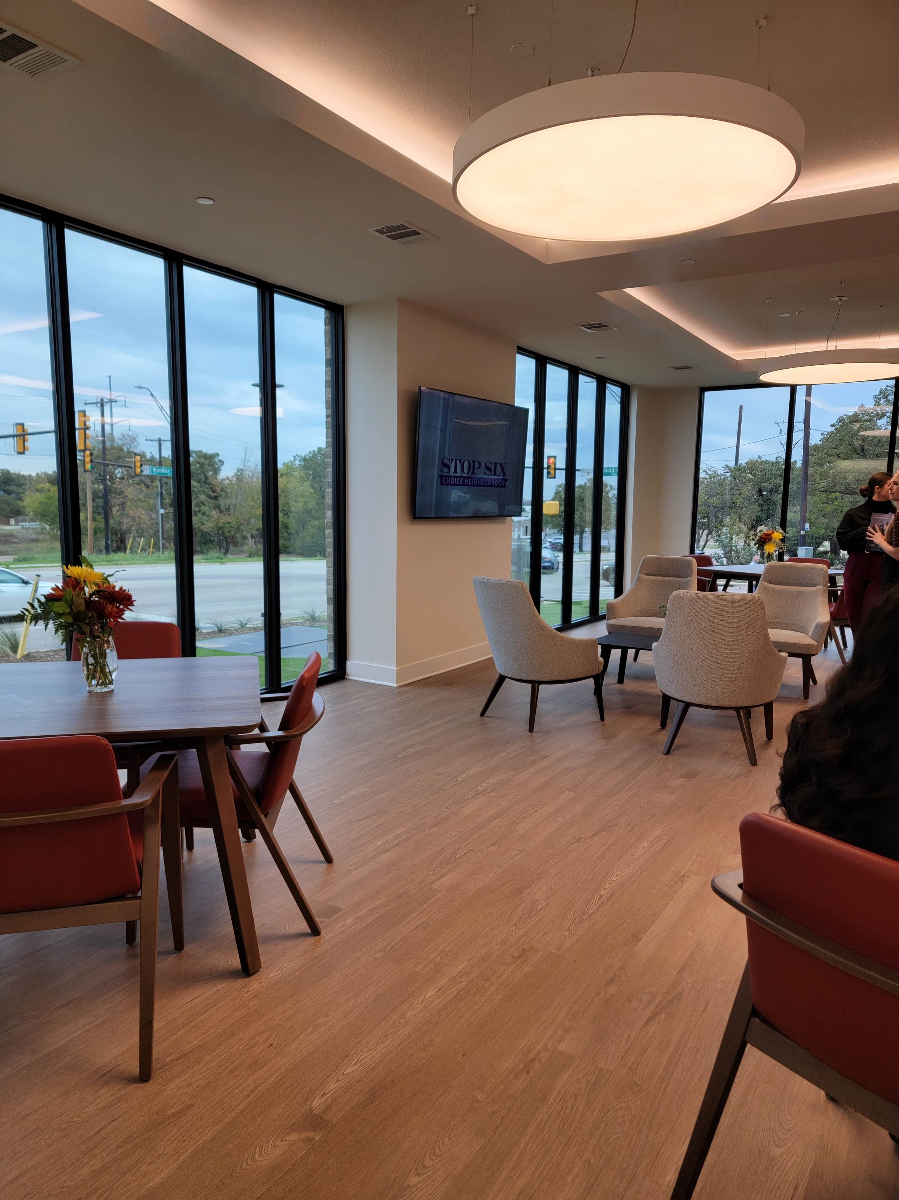
COWAN PLACE
SENIOR LIVING AT STOP SIX
PHASE I of Housing Development
174 units for Seniors 62+
163 one-bedroom and 11 two-bedroom units
18 units at or below 80% area median income (AMI)
60 units are LIHTC units for incomes at or below 60% of AMI
39 LIHTC units for incomes at or below 50% AMI
48 PBV replacement units for units demolished at Cavile Place
9 PSH units for individuals experiencing chronic homelessness
Community Amenities
Community Room and Courtyard, Fitness Center, Library, Theatre, Recreation Room, Salon, Elevator, and Public Transportation
Doctor Patient Room – Private space to meet with healthcare professionals
Case Management Services
Establish a positive rapport
Select problem-solving interventions
Access services

