Slide 1
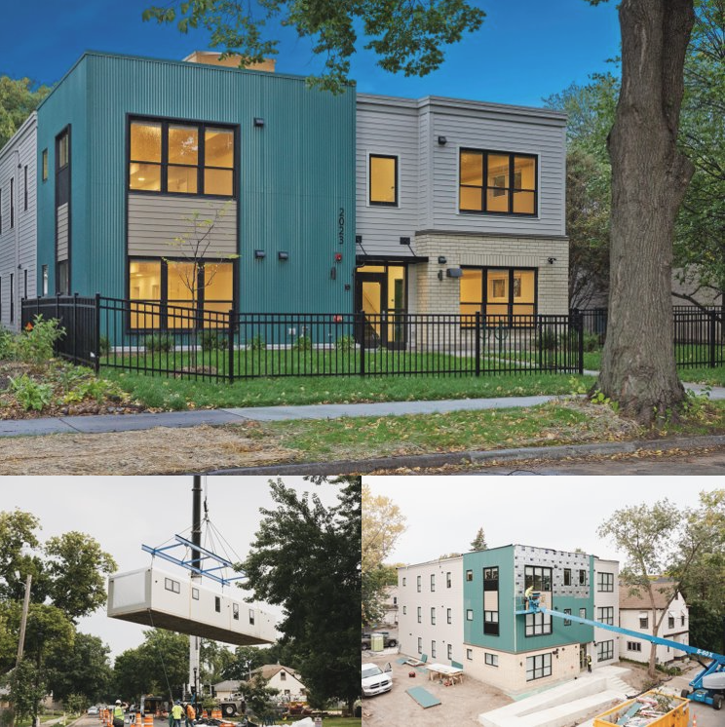
Family Housing Expansion Project
84 new, deeply affordable family housing across 16 scattered sites in Minneapolis
Serves households at or below 30% of the Area Median Income
17 units are designated for high-priority homeless families
Volumetric modular construction
Solar panels atop buildings supplies 30% of electricity needs
Significant support and funding from city and local government

