Slide 1

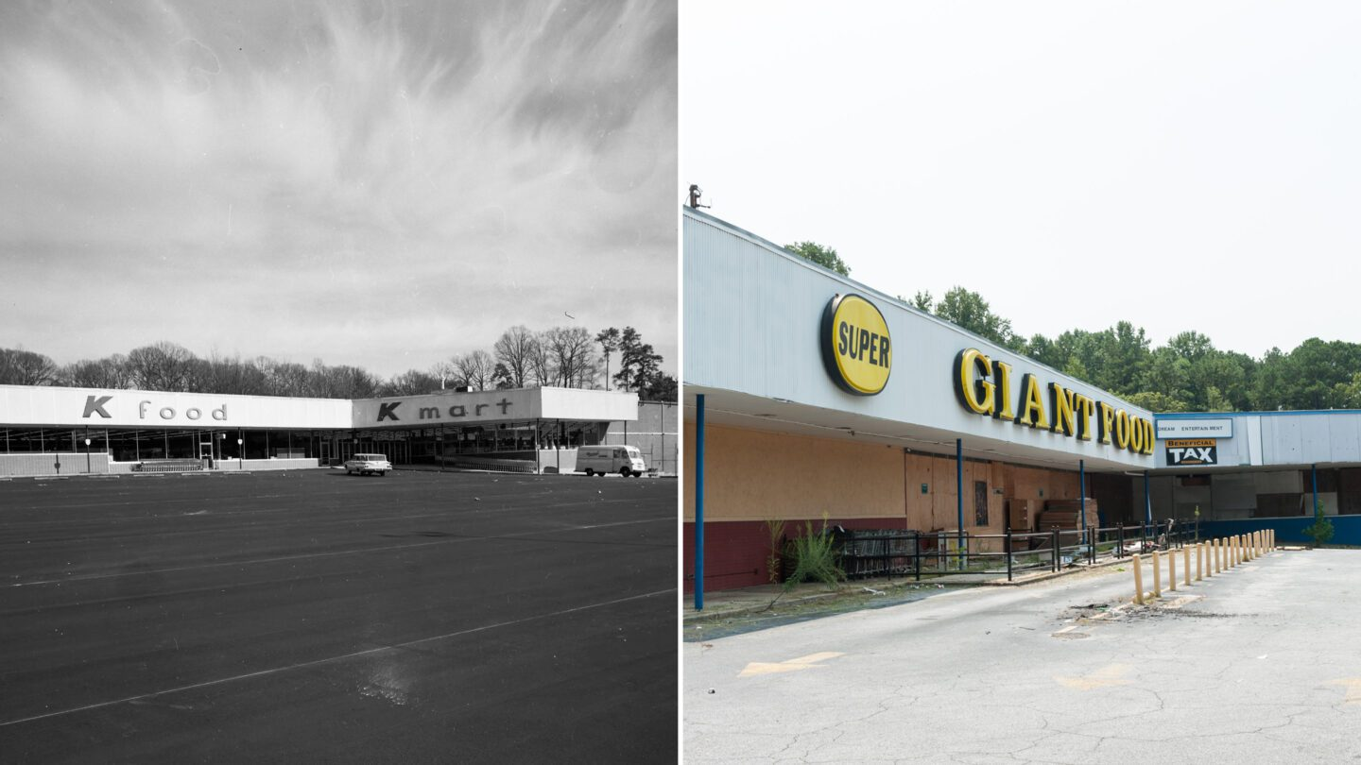
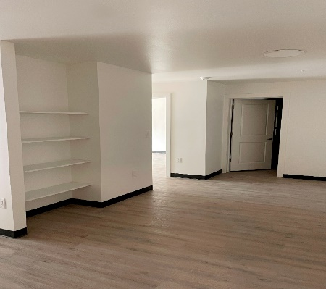
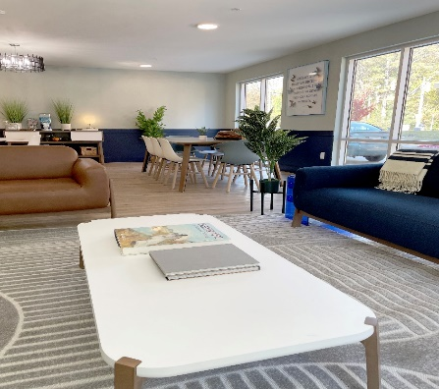
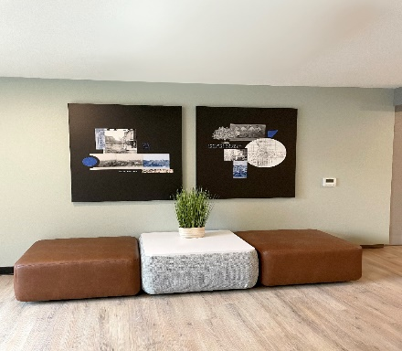
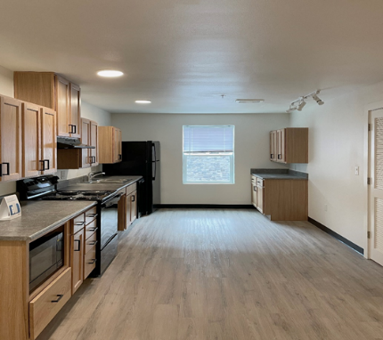
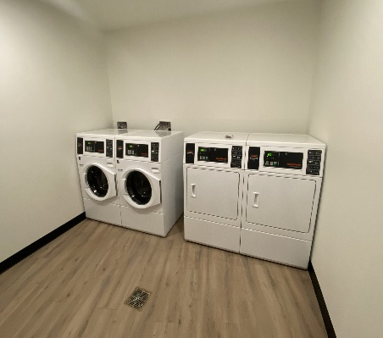
New Construction of Intrada Westside
Preventing Displacement, Providing Safe, Healthy, Affordable Housing
143 one-, two- and three-bedrooms in the Grove Park neighborhood of Atlanta
Addresses the need for safe and stable housing for youth aging out of foster care - 25 units set aside to house homeless youth; ages 18-24 years old.
The development of Intrada alongside the presence of Centerwell Health Center and Bankhead Seafood represents a significant positive transformation for the neighborhood, aligning closely with Mayor Dickens’s vision for neighborhood stabilization and community revitalization
Creates affordability to residents earning between 50 and 80 percent area median income (AMI)
The building’s attractive, modern exterior consists of brick, hardi-plank complemented by medal façade and glass store front providing maximum architectural appeal. The project received the Southface Energy Institute’s Earth Craft certification.
Public Private Partnership:
  Vecino Group – Mission Aligned Affordable Housing Developer
  Briarhouse Holdings (Clifford “TI” Harris) – Development Partner
  Invest Atlanta and GA Department of Community Affairs – Public Funders – Gap Financing and low interest debt
  Partners for Home – Grant and supportive services for PSH
  Atlanta Housing – Safe Haven Vouchers for supportive housing units
  Bank of America – Provider of construction loan
  Raymond James – Federal & State Low Income Housing Tax Credits
  Fannie Mae – Berkadia – Permanent Loan
Notes:
Hence, I believe our results speak for themselves.
It is an honor for me to lead this agency with some of the most dedicated individuals I know.

