Slide 1
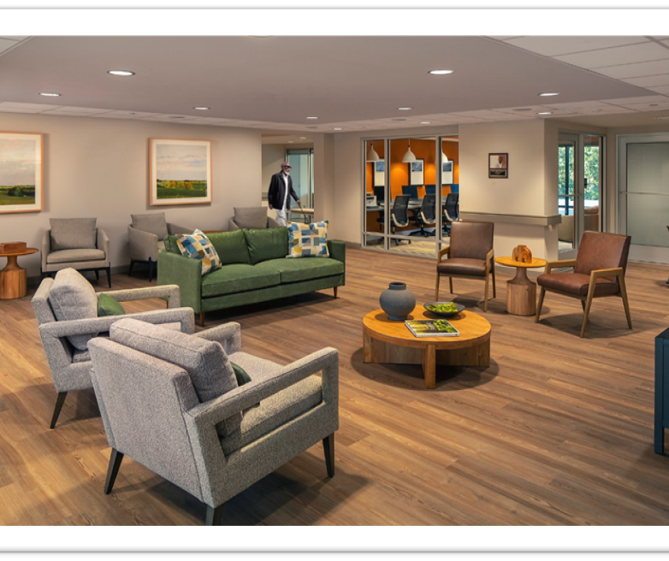
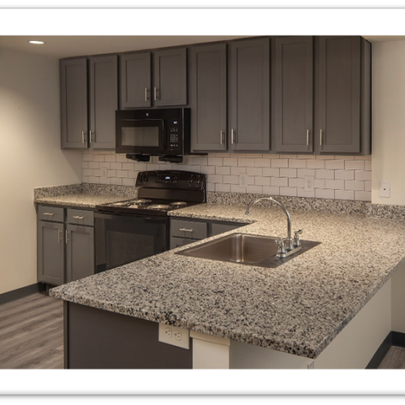
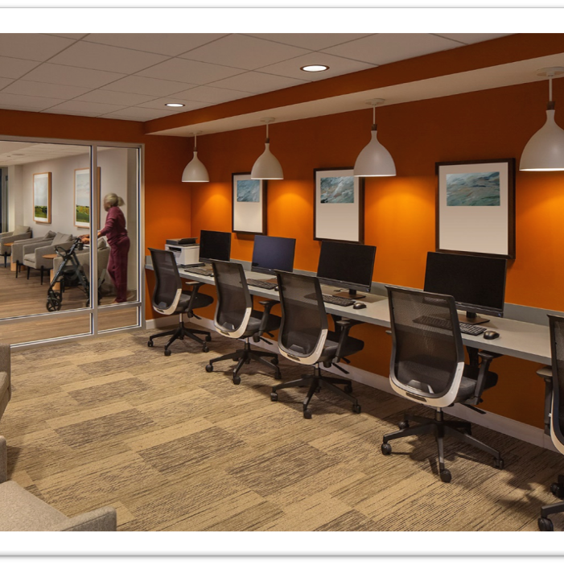
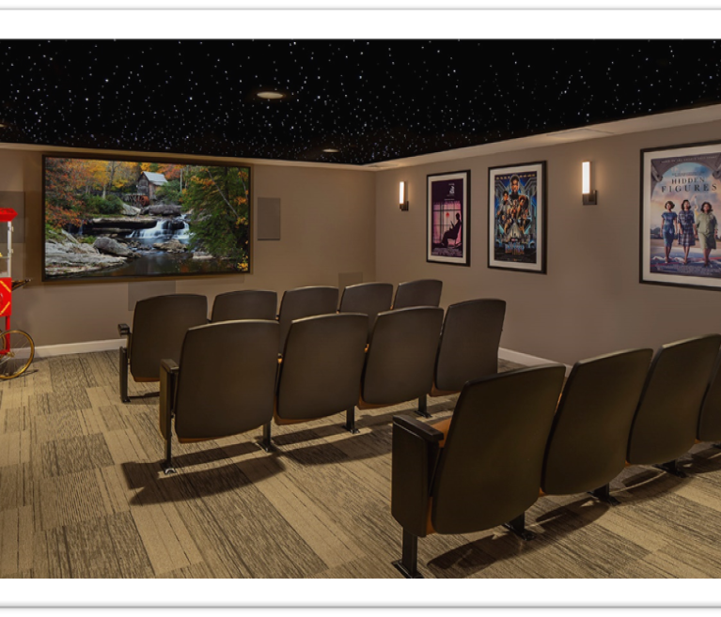
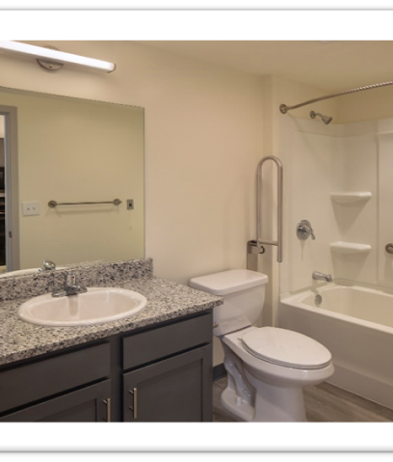
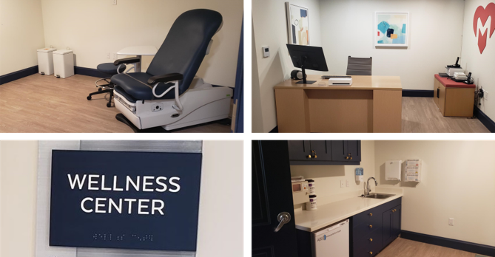
James Allen Jr. Place
Originally built in 1982, Rehabilitation completed in August 2023
129 one-bedroom units catering to residents aged 55 and older, including individuals with disabilities.
Total Development Cost of over $36 million
Funded through tax credit equity, public and private capital
Unit and Amenity upgrades including arts & crafts room, movie theater, and healthcare clinic by Matter Health.
Serves as a model for revitalizing affordable housing communities, promoting sustainability, and improving residents' quality of life

