Slide 1
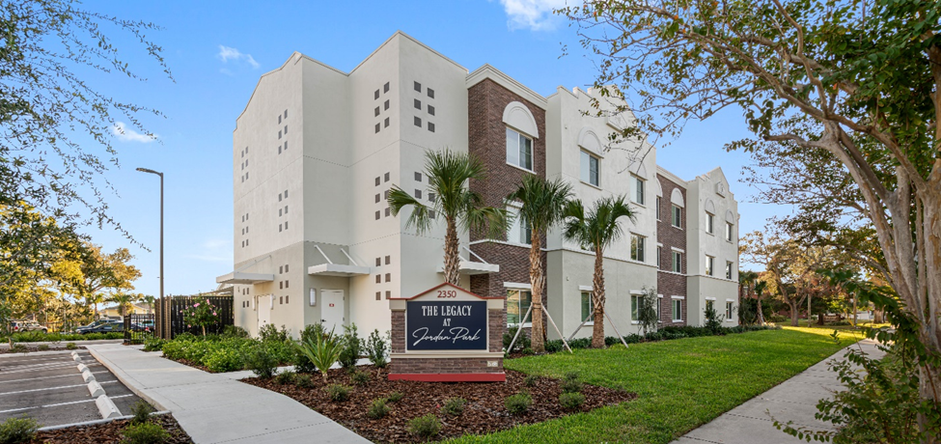
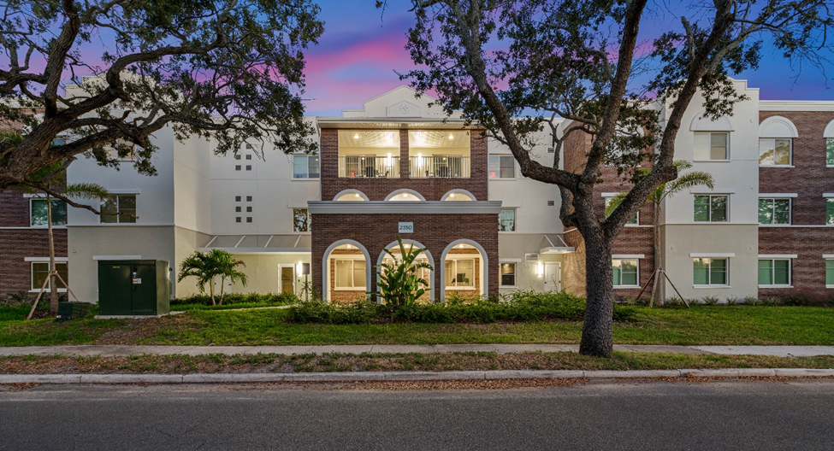
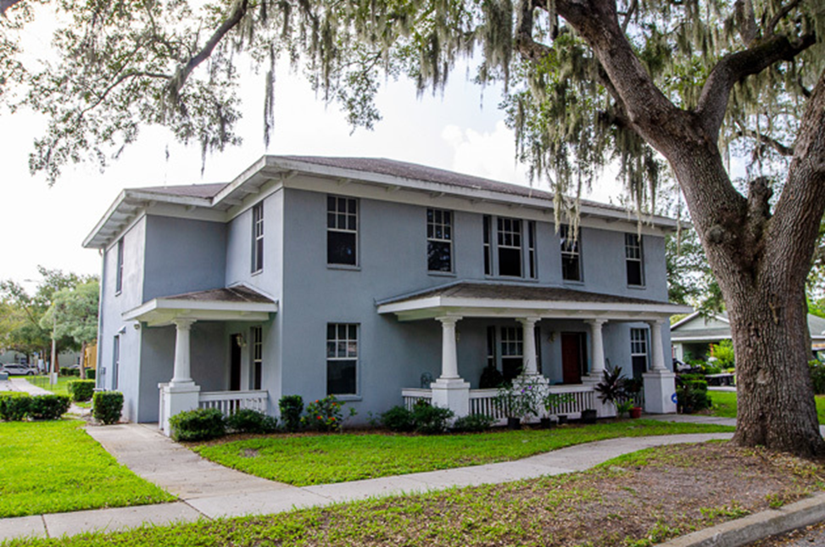
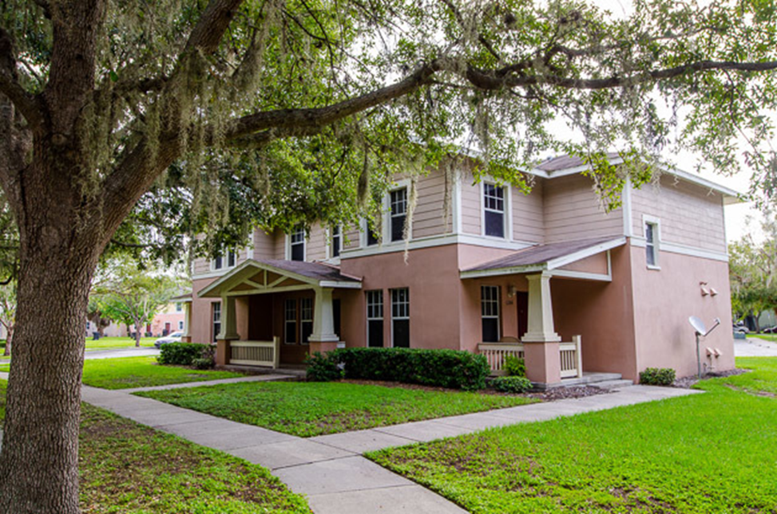
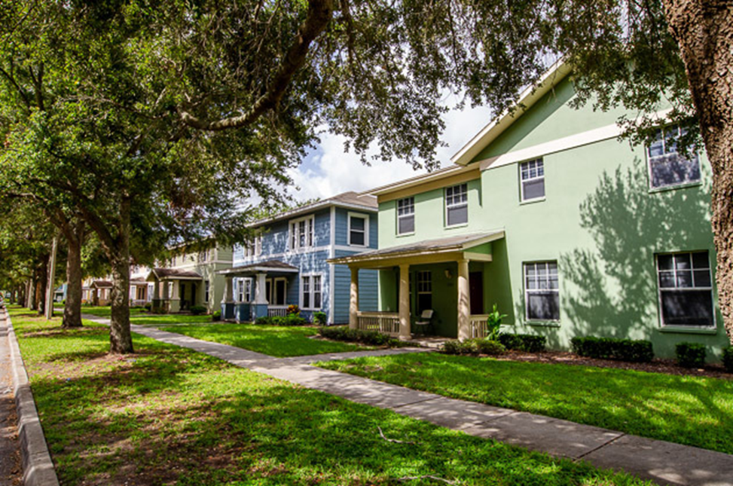
The Legacy at Jordan Park and Jordan Park Nomination for Redevelopment Award Submitted by the Housing Financing Authority of Pinellas County, FL Combination of demolition/new construction and acquisition/rehabilitation New construction 60 unit handicap adaptable senior development Rehabilitation of 206 family rental units including two-story townhouses, two-story garden type buildings, single story apartment buildings and one maintenance building Public-private partnership to finance project Rejuvenated to preserve historic significance of site

