Slide 1
PLATFORM 3750
2024 Award for Multifamily Excellence HFA of Miami-Dade County

Slide 2
Community Benefits
20,000 square feet of new retail space
Will create approximately 50 new full-time jobs and serve the community-at-large
Food desert hydrated
Aldi grocery store and Starbucks
Provision of Jobs
250 during construction and 57 permanent new jobs in the retail and building/apartment management operations
Integration with Metrorail, Metrobus and the M-Path.
Providing housing at a Metrorail station means that local employers will have employees who can easily access their jobs

Slide 3
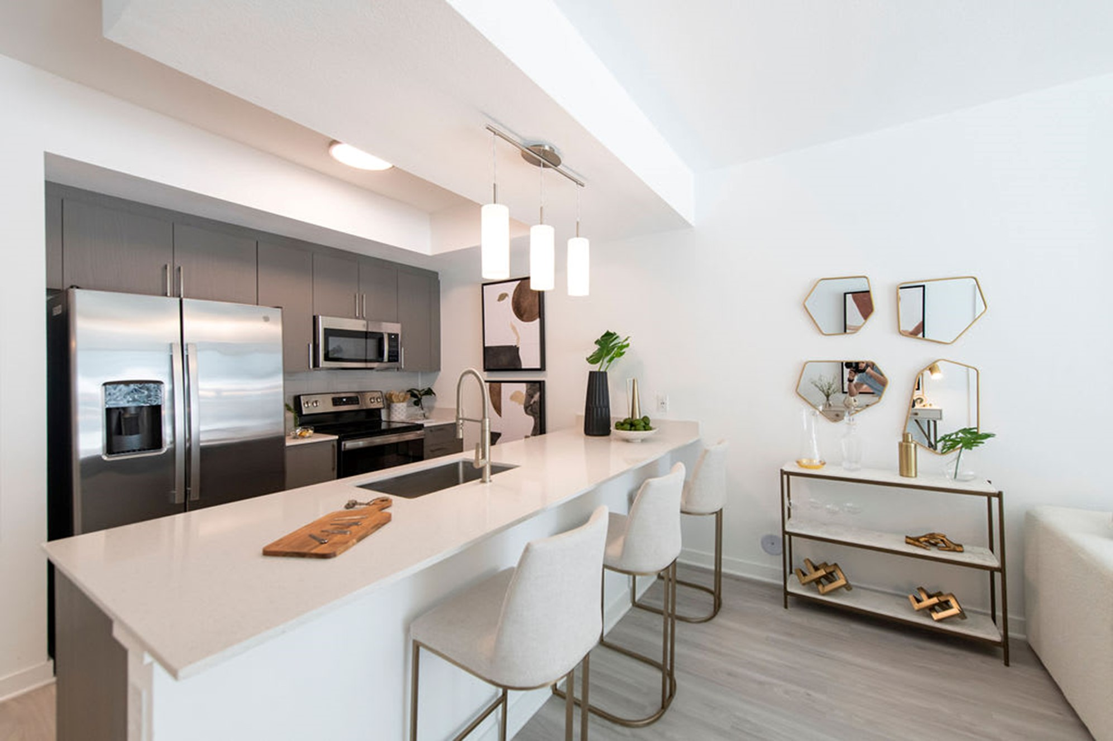
Interior
Quartz or granite countertops
Full-size washer/dryers
European-style cabinetry

Slide 4
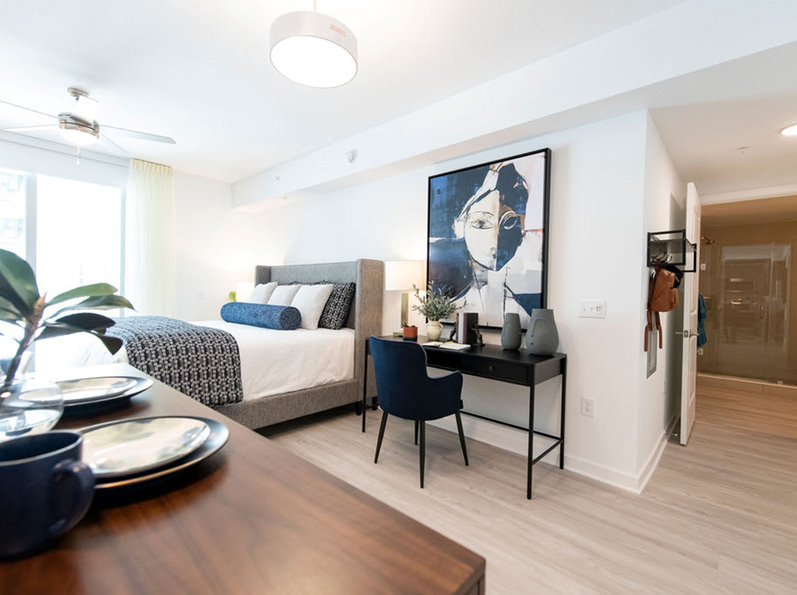
Interior
Key fob entry systems and intrusion alarms
Full energy-efficient appliance package including dishwasher and microwave
Wood-plank flooring in the living areas

Slide 5
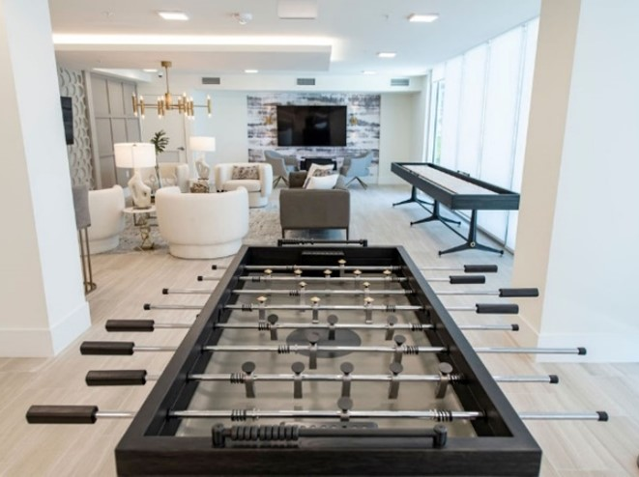
Community Areas
Fully equipped fitness center with virtual fitness classes
Rooftop pool and Clubroom
Business center
On-site 24-hour management

Slide 6
